Slide 1
WE CREATE OUR OWN BUSINESS.
Made by:
INES RUDELIĆ, MA in Political Science
Association LIBERA for Education and Self-employment
Ostrovička 4, 10000 Zagreb
Tel. +385 (0)1 8893675, +385 (0)95-850-83-99
Zagreb, 05.11.2014.

Slide 2
Croatian Employment Office
Understanding the situation

Slide 3
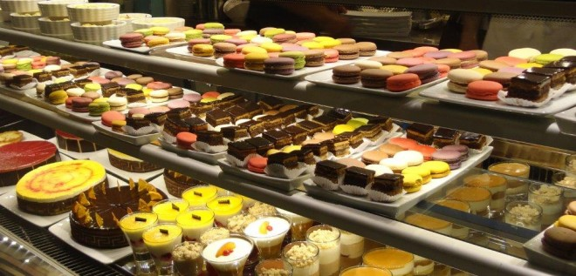
Self-employment steps
Reward

Slide 4
Croatian Employment Office
Referent for self-employment

Slide 5
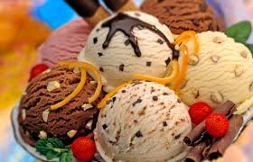
Self-employment steps
Reward- patisseries

Slide 6
Self-employment steps
Motivation

Slide 7
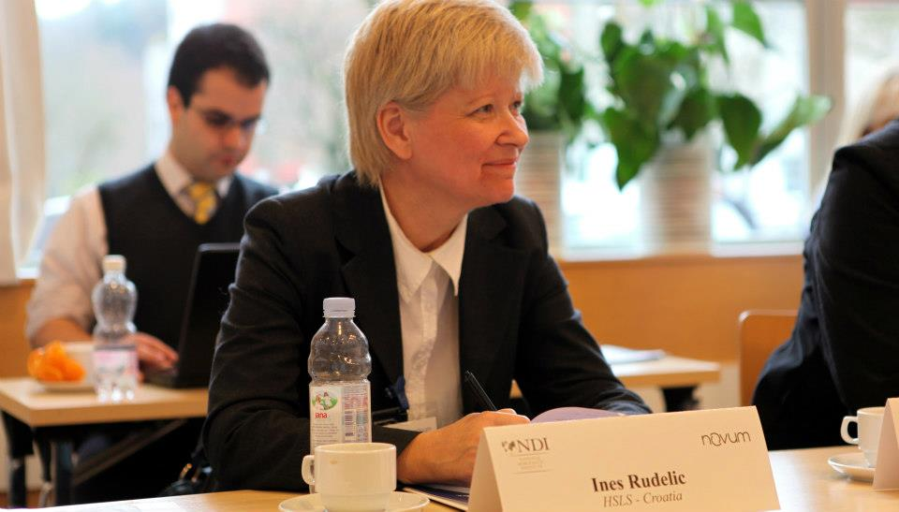
Self-employment steps
Surround yourself with those who support your work

Slide 8
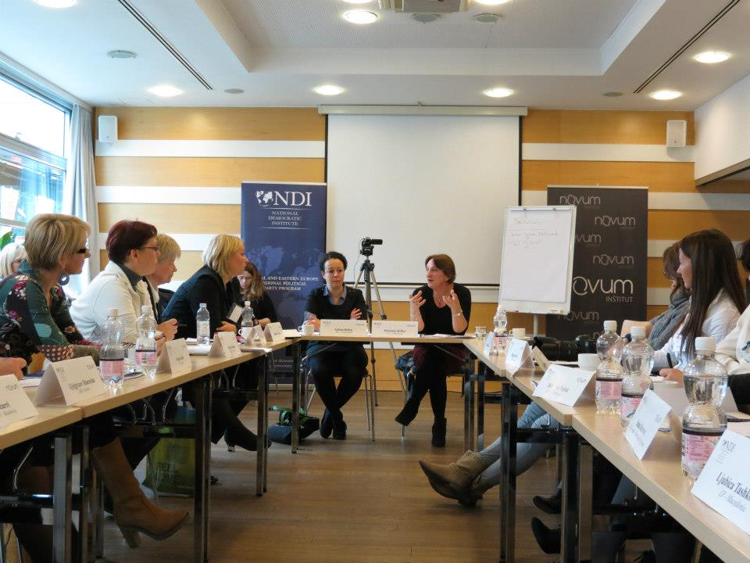
Self-employment steps

Slide 9
Self-employment steps

Slide 10
Self-employment steps

Slide 11
Self-employment steps
Idea

Slide 12
WE CREATE OUR Own business.
Made by:
INES RUDELIĆ, MA in Political Science
Association LIBERA for Education and Self-employment
Ostrovička 4, 10000 Zagreb
Tel. +385 (0)1 8893675, +385 (0)95-850-83-99
Zagreb, 05.11.2014.

Slide 13
Self-employment steps
Persistance

Slide 14
Self-employment steps
Developing my idea

Slide 15
Self-employment steps
Connecting with Entrepreneurs

Slide 16
Self-employment steps
Avoid negative people, emotions, attitudes
Be the change you wish to see in the world. Gandhi

Slide 17
Self-employment steps
Believe in yourself,
be different,
and success
will come

Slide 18
Statistics
Until now there had been held 4 workshops in August 2013 in CISOK centre (of Croatian Employment Office), address Knez Višeslav 7, Zagreb, which were attended by 55 women, age 20-55
Until now there had been held 8 workshops during 2014 in Centre for Culture Trešnjevka, which were attended by cca 83 men and women, age 20-55
By current informations cca 30% of the attenders started their own business

Slide 19
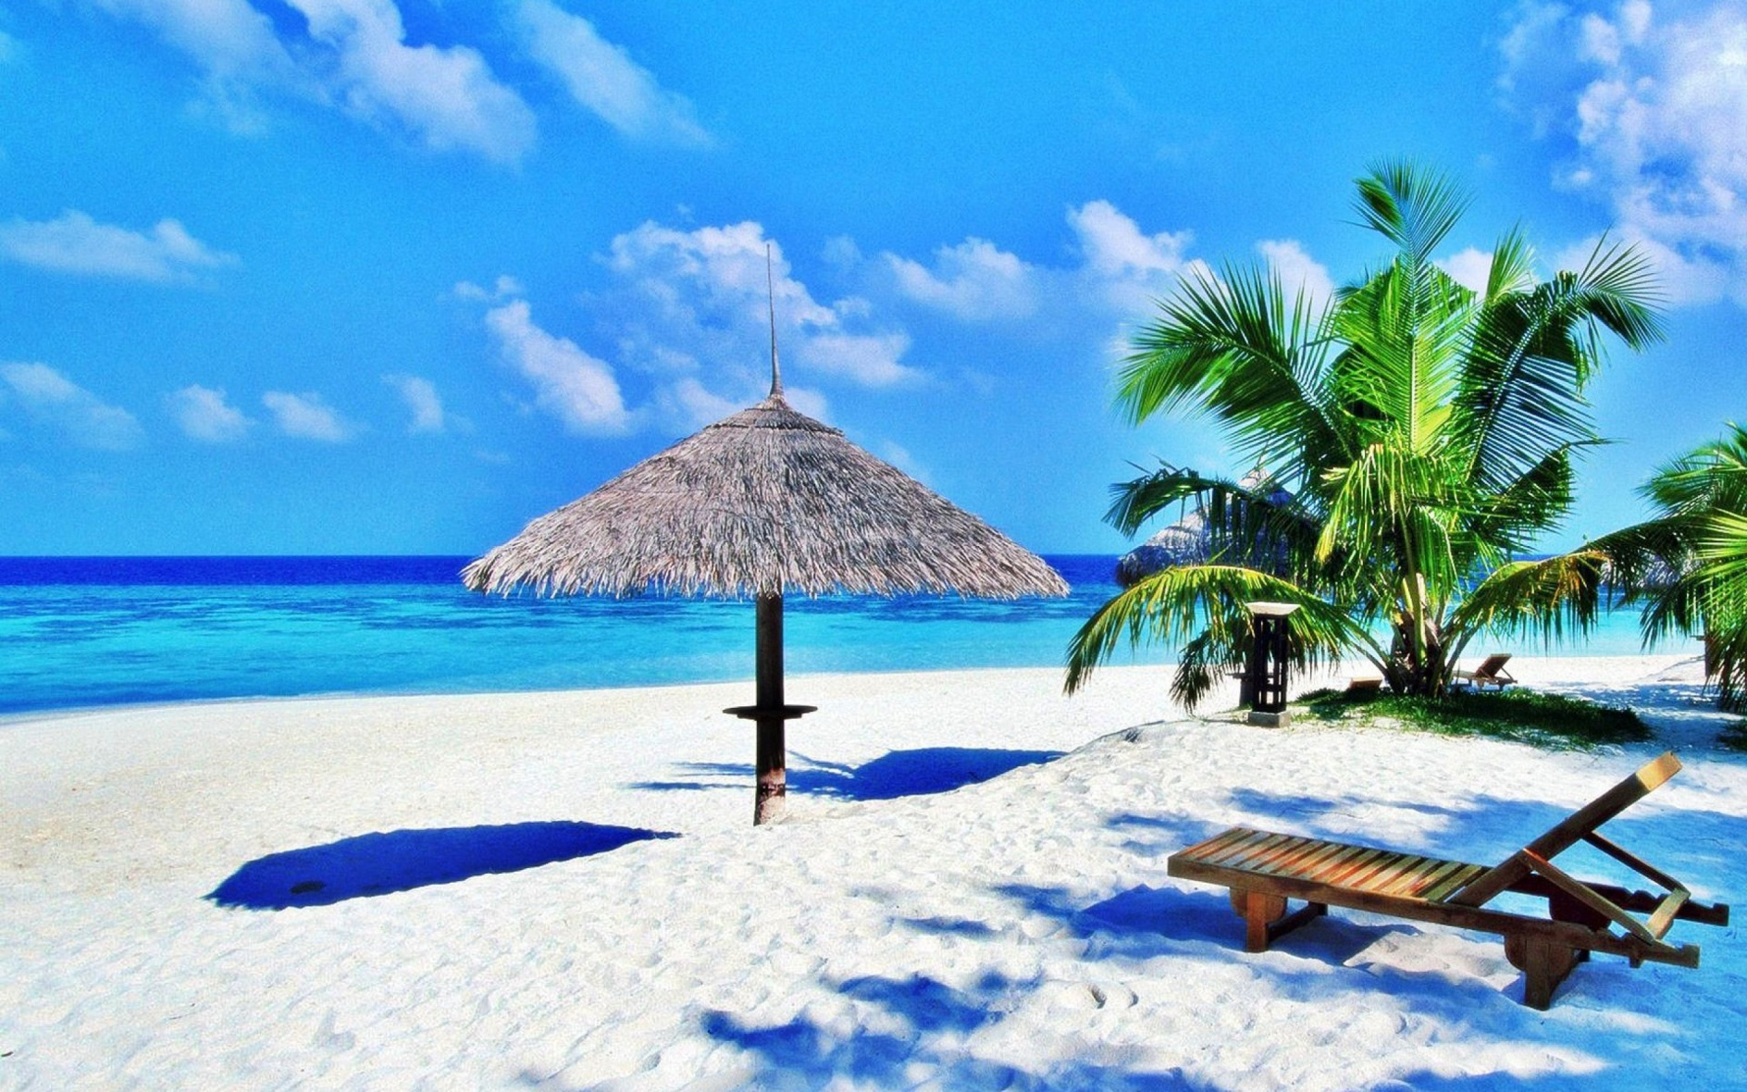
Reward

